Slide 1
Intrusion Detection System Using a Neural Network
Phase One Presentation
Blake Knedler

Slide 2
Agenda
Project Vision and Overview
Project Requirements
Project Plan
Cost Estimation using COCOMO
Architecture Elaboration Plan (Phase Two)
Software Quality Assurance Plan
Risks and Concerns
Alpha Prototype Demonstration
Questions and Comments

Slide 3
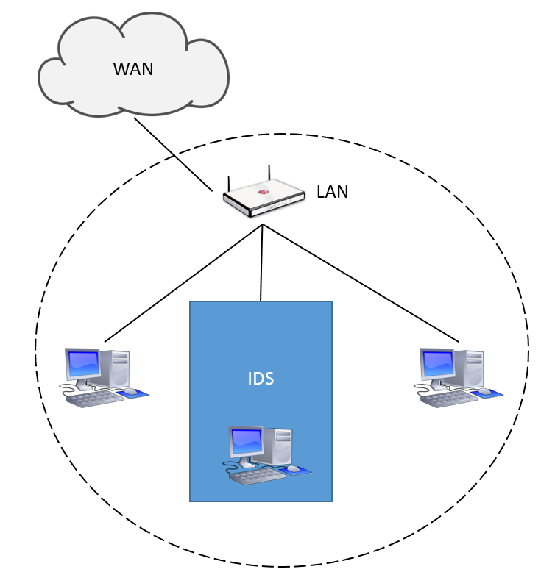
Project Vision and Overview
Intrusion Detection System
Host-based system
Read TCP/IP Packets
Neural Network Decision Making
Notification System
Logging System

Slide 4
Project Vision and Overview
Goals for the Intrusion Detection System
Create a TCP/IP layer to read all packets received by host system
Create a Neural Network layer to make decisions if the packet is a DOS attack
Neural Networks are not perfect, aim for 90% accuracy
Create a notification system for when a malicious packet is received
Motivation
Create a tool to help prevent DOS attacks
Allow for future work to completely prevent DOS attacks when noticed

Slide 5
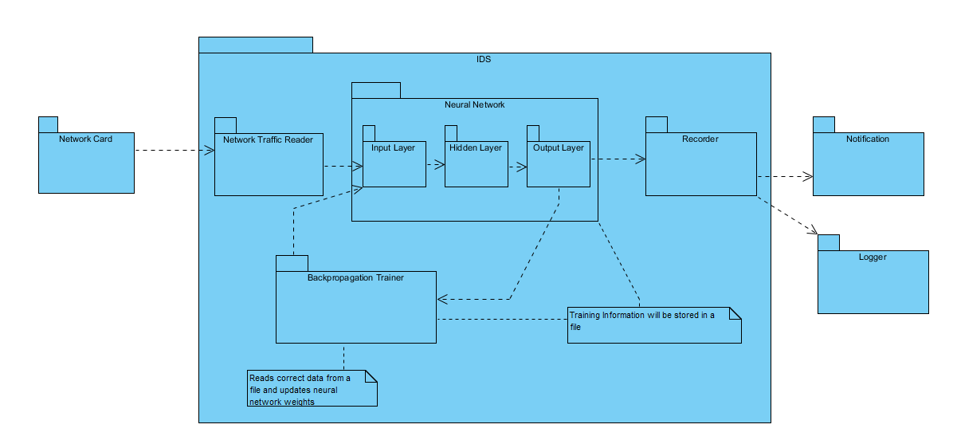
Project Vision and Overview

Slide 6
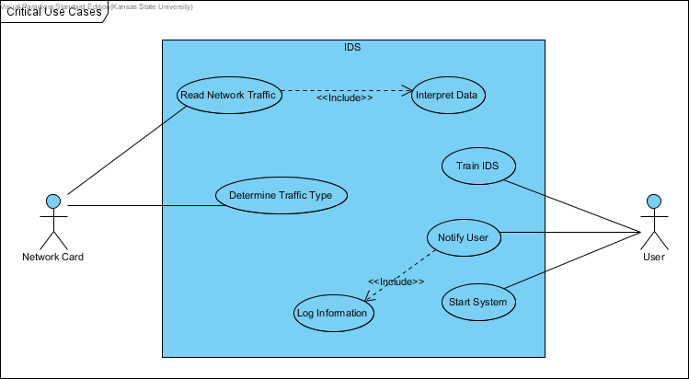
Project Requirements

Slide 7
Project Requirements
SR1.1: [CR] The System shall be able to read data from the host system network card.
SR2.1: [CR] The system shall be able to interpret the data from the received network traffic and store it in a usable format.
SR3.1: [CR] The system shall be able to determine if the network data received by the host machine is malicious with at least 85% accuracy.
SR3.2: The system shall determine what type of attack is being made to the host network when malicious network traffic is found.
SR4.1: [CR] The system shall be able to train itself through backpropagation on know network traffic data.
SR5.1: [CR] The system shall be able to notify the User of the host system when a malicious attack is encountered.
SR6.1: The system shall be able to log all malicious attacks into a log file.

Slide 8
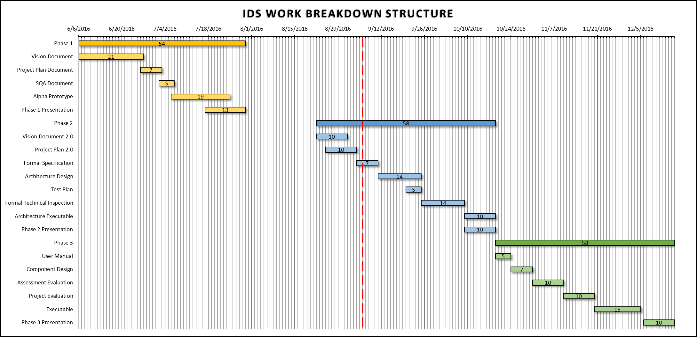
Project Plan

Slide 9
Cost Estimation Using COCOMO

Slide 10
Architecture Elaboration Plan
Revise Vision Document
Revise Project Plan
Create Formal Specification
Create Architectural Design
Create Test Plan
Conduct Technical Inspection
Create Executable Architecture Prototype

Slide 11
Software Quality Assurance Plan
Management
Software Reviews
Testing
Problem Reporting
Tools, Techniques, and Methodologies
Revision Control
Notes:
Management:
You all are the Supervisory Committee with Dr. Neilsen being the Major Professor
Technical Inspectors: Tracy Marshall and Keith Moyer
Software Reviews:
This will come in the form of these presentations along with the technical inspections done.
Testing:
A detailed test plan will be given during the second phase of the project, which will assess the critical requirements.
Problem Reporting and Corrective Action:
Any issues reported by the committee or the technical inspectors will be reported and any needed corrective action will take place. Depending on the issue type, it can be noted and documented through the documentation in latter phases or through the GitHub Issue reporting system.
Tools, Techniques and Methodologies:
Visual Studio IDE – Currently Python 3.5 (possibly switching to 2.7 due to TCP/IP libraries)
Documentation is through Microsoft Office 365 Suite of tools
UML Diagrams through Visual Paradigm
Revision Control:
Git via GitHub

Slide 12
Risks and Concerns
Correctly reading all information needed from the TCP/IP packets quickly
Quickly reading all the packet information into the neural network
Tweak the neural network as necessary in the attempt to get as many correct answers as possible.

Slide 13
Alpha Prototype Demonstration
GitHub Repository Location:
https://github.com/bneedy/PyIDS
Worked on the most complex part of the system, the neural network.
Aimed at training the system with a few hundred messages and see how it handled a larger dataset.
Had around 90-95% accuracy on around 450,000 messages training the system with around 200 messages.

Slide 14
Questions and Comments

